Slide 1
Local Authority EV & EV Charging
Staying Informed and Supporting your Residents – an update for Warwickshire Communities
Richard Mallender
Sept 2026

Slide 2
About Energy Saving Trust
Impartial
  An independent organisation working to address the climate emergency
  Provide leadership and expertise leading the way to a zero-carbon society
  Work with individuals, businesses, communities and governments showing practical ways to save energy and reduce carbon emissions
  A trusted partner with over 30 years of experience
  Offices in England, Scotland, Wales and Northern Ireland
Electric Vehicle Infrastructure Support Scheme (EVISS)
We offer advice on EV strategy, procurement and sustainable travel, working alongside and our Fleet Team that advises fleet managers on reducing costs and emissions
We manage a number of grant schemes on behalf of the Office for Zero Emission Vehicles (OZEV)
Expert
Collaborative
Innovative
Supportive
Determined
Notes:
Introduction to the Energy Saving Trust and the EVISS programme.

Slide 3
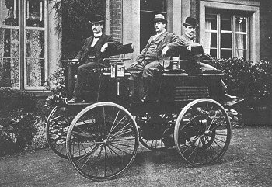
Electric Vehicles, Charging & Chargepoints
The switch from Internal Combustion Engines to Electric Motors
State of the EV Market, Policy and Progress
Charging – Opportunity & Choice
LEVI – boosting On Street charging
    A National Programme
    Community & Investment
    Jobs, Training, Economic Development
Mythbusting
Accessibility
Q&A
Thomas Parker electric car – produced from 1884 (photo 1895)
Notes:
Overview of topics to be covered. Photograph of old electric car included to make the point that technologies change and that old ideas can re-emerge

Slide 4


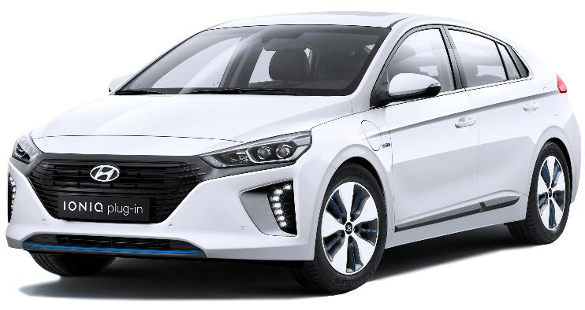





BEV and PHEV, Hybrid ICE / Electric vehicles
    Battery electric vehicle (BEV)
  Plug in hybrid electric vehicle (PHEV)
Renault 5
MG4
Mini Countryman
Hyundai IONIQ
    Self-charging hybrid (HEV)
  Mild hybrid (MHEV)
Toyota Prius
Honda Jazz
Ford Puma ST
Nissan Qashqai
Notes:
Overview of the different types of vehicle that incorporate electric power in whole or in part to their drive train.

Slide 5
The switch to EVs: Policy & Progress

Slide 6

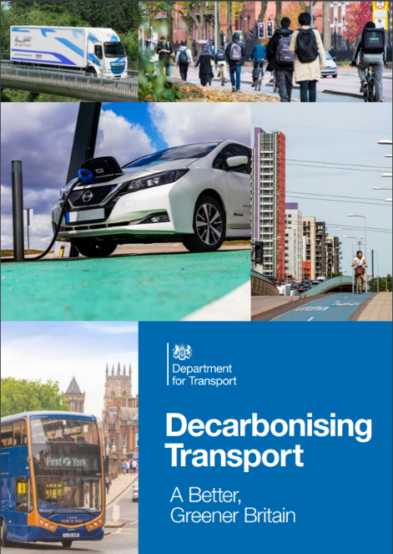
Why the push for electric vehicles?
Reduced CO2 Emissions, addressing Climate Change
Switching away from reliance on fossil fuels to power vehicles will reduce CO2 emissions and help address climate change.
At present transport accounts for approx. 26% of all UK carbon emissions and is growing in output
There is a surge in demand for freight and logistics due to the growth of online shopping
Consumer demand for larger SUV-style vehicles has also increased emissions
Notes:
Policy explainer, Climate Change.

Slide 7

Why the push for electric vehicles?
Cleaner Air & Less Pollution
Poor air quality is estimated to cause 29,000 to 43,000 deaths a year in the UK (DEFRA - Committee on the Medical Effects of Air Pollution, 2017)
Removing all fine particulate air pollution would have a bigger positive impact on life expectancy in England and Wales than eliminating passive smoking or road traffic accidents.
The estimated economic cost from the impacts of air pollution in the UK was estimated at £157 million with the latest findings, published in a report from Public Health England, warning that these could reach up to £18.6 billion by 2035.
Polluted air from cars and other sources seriously damages health - contributing to cancers, dementia, heart disease, strokes and more.
The main pollutants of concern in the UK are particulate matter (PM), oxides of nitrogen (NOx), and ground level ozone (O3).
Other important air pollutants relevant to public health include sulphur dioxide (SO2), non-methane volatile organic compounds (NMVOCs) and ammonia (NH3).
Notes:
Policy explainer, Cleaner Air.

Slide 8

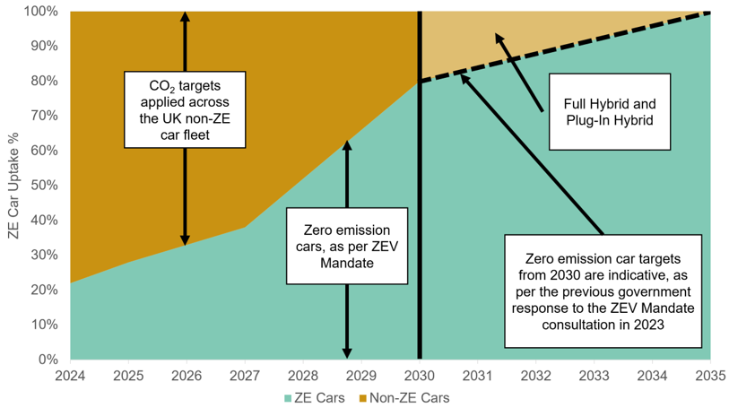
ZEV Mandate
Decarbonising road transport - increasing ZEV supply and limiting emissions from non-ZEVs - is crucial to delivering net zero by 2050 and interim carbon budgets
The ZEV Mandate sets annually increasing headline targets for the proportion of new zero emission cars and vans sold in the UK, starting at 22% for cars and 10% for vans in 2024, on a pathway to 100% by 2035. The headline targets for 2026 are 33% for cars and 24% for vans
The ZEV Mandate is the largest single carbon saving measure across Government and fundamental to the UK’s commitment to reach net zero by 2050. Regulations limiting CO2 emissions from new non-ZEVs sit alongside the Mandate, with hybrids and low carbon fuels playing a role in non-ZEV CO2 savings
Sales of new petrol and diesel cars end 2030
Hybrids (“Self-Charging” & “Mild”) to be sold until 2035 – e.g. Toyota Prius
Small or low volume manufacturers exempt
Current ZEV Mandate car uptake trajectories with 2030 phase-out - Source: DfT analysis
Notes:
Policy explainer, ZEV mandate.

Slide 9
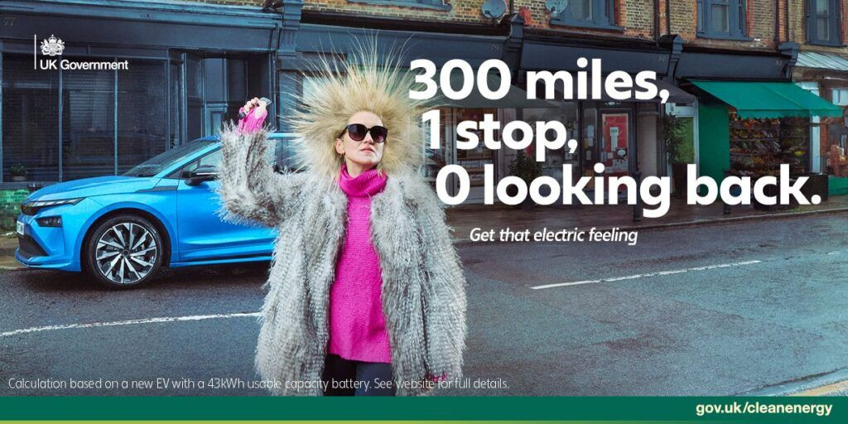
Timeline: Promotion and EV grant
The UK Government has launched a campaign to promote electric vehicles across TV, radio and digital outlets.
The campaign highlights how drivers can save up to £3,750 off the cost of a new EV through the Electric Car Grant, alongside up to £1,400 on annual fuel and maintenance costs
The Department for Transport (DfT)’s “Get that electric feeling” campaign.
https://www.gov.uk/government/news/get-that-electric-feeling-new-campaign-launched-to-show-savings-and-benefits-of-going-electric
Notes:
Policy explainer: government promotion.

Slide 10

How many vehicles are there on the roads?
Source: Motorparc Vehicles in Use (UK) - SMMT
Notes:
There was also a significant shift away from plug-in hybrids towards battery-electric cars, with plug-in hybrid sales declining year on year, while battery-electric vehicle sales have increased.

Slide 11
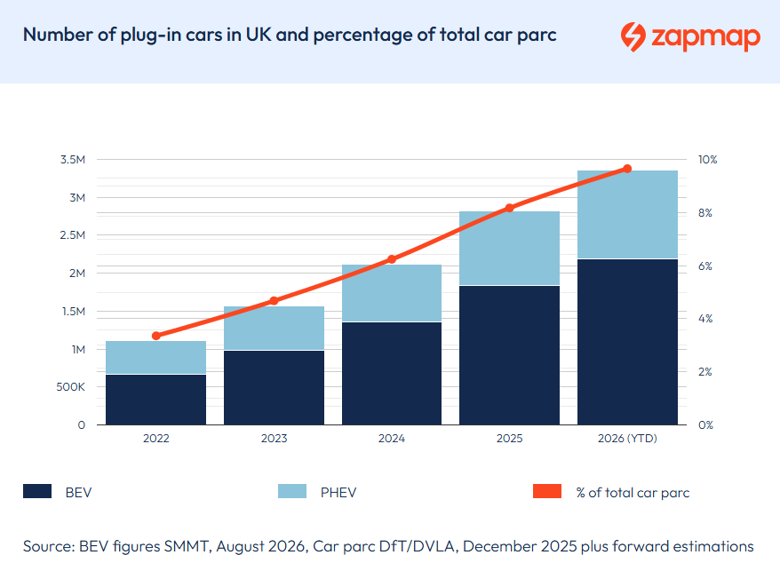
BEVs and PHEVs: Current market share
As of the end of August 2026, 3,358,019 are plug-in vehicles, about 8.2% of the total.
Over 2.1 million BEV
Over 1.1 million PHEV
BEVs are consistently outpacing PHEVs in the market, now comprising 65% of plug-in vehicle sales.
Source: https://www.zap-map.com/ev-stats/ev-market
Notes:
Used cars are following a similar trend. Petrol remains the best-selling powertrain, rising 1.5% to represent more than half (56.7%) of the market. Diesel declined by 3.5%, to account for a third (33.1%) of sales.

Slide 12
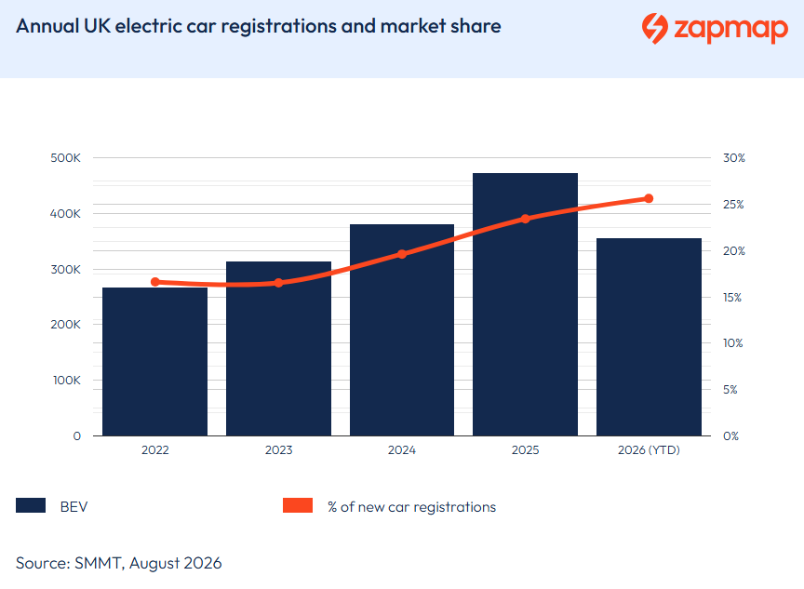
BEVs and PHEVs: Current market share
As of the end of August 2026, there have been 355,746 fully electric cars registered.
EVs account for 25.6% of ALL new car sales so far this year.
Source: https://www.zap-map.com/ev-stats/ev-market
Notes:
Used cars are following a similar trend. Petrol remains the best-selling powertrain, rising 1.5% to represent more than half (56.7%) of the market. Diesel declined by 3.5%, to account for a third (33.1%) of sales.

Slide 13

The Change is Global
Globally, one in four new cars sold in 2025 was electric
China remained the largest EV market, with sales growing 17% due to domestic competition and price reductions, pushing EVs to account for around 60% of total car sales in the country
Europe experienced the fastest growth, with EV sales rising 33%, driven by Germany (+48%) and the UK (+27%)
Global EV sales reach 20.7 million units in 2025, growing by 20%
Notes:
Demonstrating that the shift is global, not just a local or national trend.

Slide 14

“I can’t drive far enough!”
Myths, Misinformation & Biased Reporting
“Batteries degrade quickly & only last 2 or 3 years”
Ranges are already more than enough for most journeys and commutes. Most people only need about 25 miles a day and most cars eligible for the £3,750 grant can do 200 miles.
Not true. A 2025 test of over 8000 EV batteries found they “are performing materially better, and degrading more slowly, than many market participants and consumers have been led to believe.
Across age, mileage and segment, average battery State of Health remains high, warranties are rarely tested and well used vehicles frequently outperform expectations”
Generational 2025 Battery Performance Index - Generational
“There’s no real CO2 savings”
Lifetime emissions of a typical EV are half that of a petrol or diesel car.
Emissions from battery production can vary across different countries and add to the initial carbon footprint compared to a petrol or diesel car
BUT ! After the first 8,000 miles (13,000 km) or so the continued burning of fossil fuels by the ICE car greatly exceeds emissions from an EV. It’s better to switch sooner.
Transport & Environment research
“What about Fire Risk?”
“The Grid can’t cope!”
    EV battery fires are rare. Reignition of a battery fire is possible, but not common.
    EVs are safety-tested like any other car, it’s not like cheap scooters from cut-price dealers on the internet
    Special equipment is needed to fully and safely extinguish an EV battery fire, and Fire & Rescue services are equipped to handle these.
    The actual degree of hazard from an EV car fire vs an ICE car fire are about the same
    Free Documents | Fire Protection Association
Everyone won’t switch to EVs overnight it will be gradual, perhaps over a decade
Growth in renewable energy production, battery and other storage will ensure that energy will be adequate to meet future demand.
Billions are being invested already to upgrade the network.
The nation’s peak demand has fallen by 16% since 2002 due to improvements in energy efficiency
We can spread out the demand by incentivising smarter charging habits
Notes:
Explainer. Typical myths and actual information.

Slide 15
Charging Up: On Street and On the Go

Slide 16
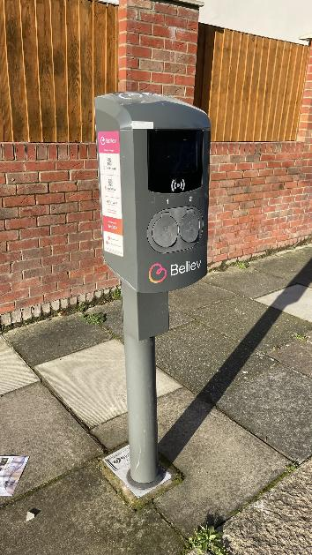
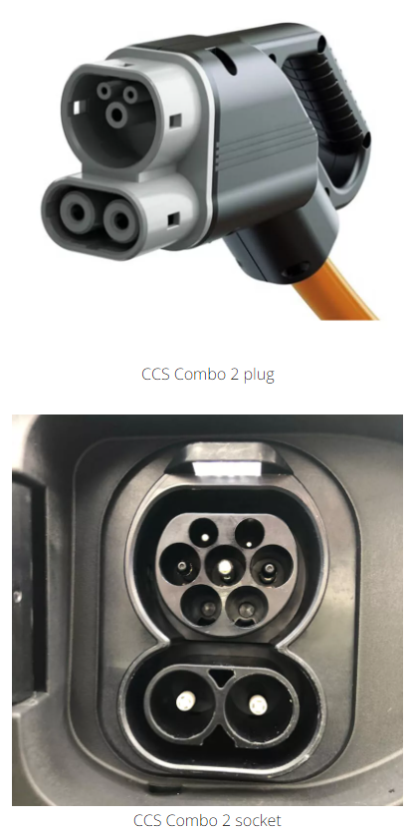

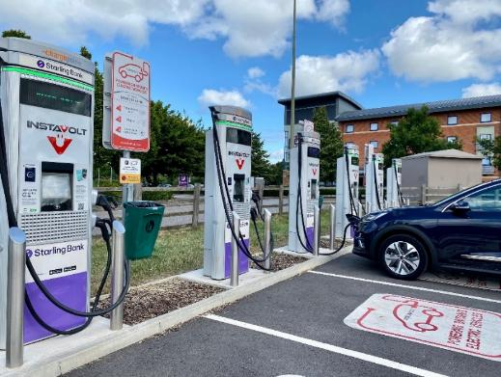
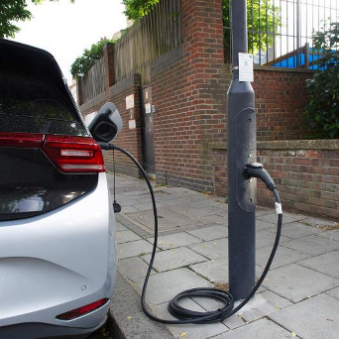
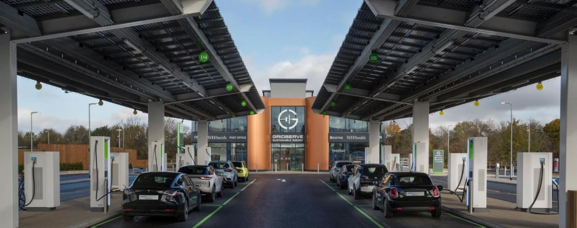
Charging types
Standard
3.7 – <8kW AC
Standard plus
8 – <50kW AC
Rapid
50 – <150kW DC
Ultra-rapid
150kW+ DC
Notes:
Explainer. Different types of charger and what the terms mean.

Slide 17
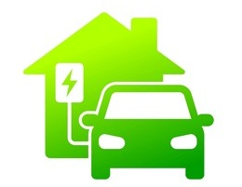
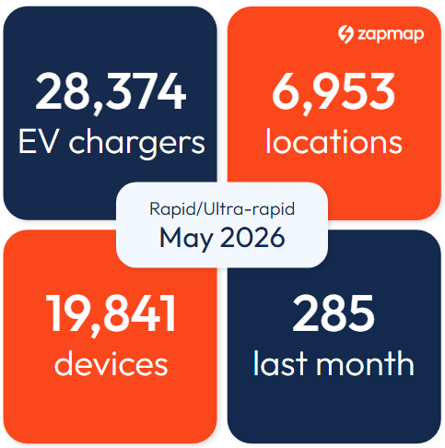
How people charge their cars
Most of the time, most EV owners charge their car at home using a Standard (7kW) charger connected to their own electricity supply, often with the vehicle parked on their own driveway.
It’s the cheaper, more convenient option.
Of the 28.4 million households in the UK, an estimated 19 million (67.2%) of them have access to a driveway or dedicated parking space close to their house.
Drivers generally use Rapid and Ultra-Rapid chargers while on longer journeys. But they are more expensive and costlier to install and operate.
Source: https://www.field-dynamics.co.uk/research/public-charger-catchment-research/
Notes:
Look at how most people charge their EV.

Slide 18

Requirement for increased near home charging
This still leaves approximately eight million households (32%) in England that do not have access to off-street parking, such as a drive, garage or residential car park.
Lack of charge points, particularly amongst this group, has been identified as a major barrier to the adoption of EVs.
To overcome this requires a huge increase in chargers on-street near residential homes so this group can charge safely and conveniently overnight.
Source: Statistics from the Government’s English Housing Survey (EHS)
Notes:
Highlight the issue for those unable to charge at home.

Slide 19
The LEVI Fund:
Private Investment; The role of Local Authorities

Slide 20
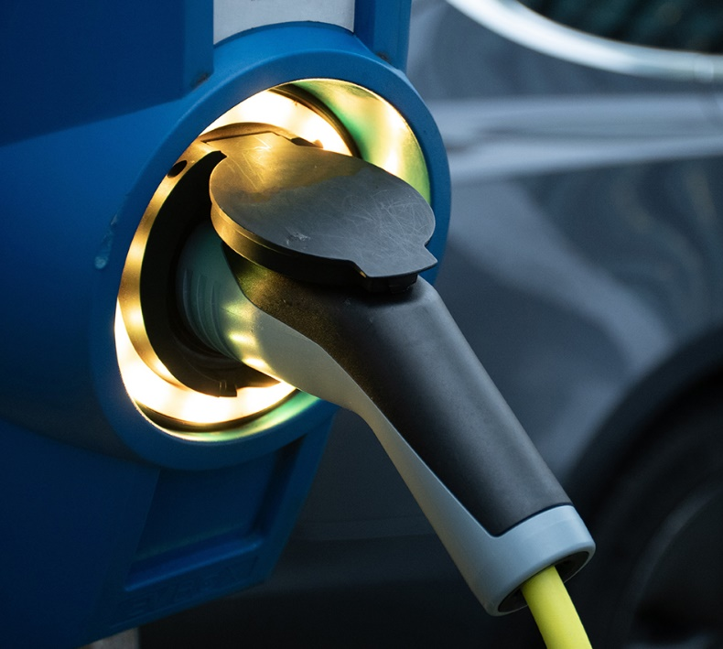
Local Electric Vehicle Infrastructure (LEVI) Fund
Launched with two key objectives…
Delivering a step-change in the scale of deployment of local, primarily low power, on-street charging infrastructure across England.
Accelerating the commercialisation of, and investment in, the local charging infrastructure sector.
Capital funding allocated to all Tier 1 LAs in England to support deployment of infrastructure ahead of need.
Capability funding to increase capacity and capability of every Tier 1 local authority and enable them to have a published EV infrastructure strategy.
Provision of tools, training, and sharing of best practice via the LEVI Support Body.
Notes:
LEVI overview.

Slide 21
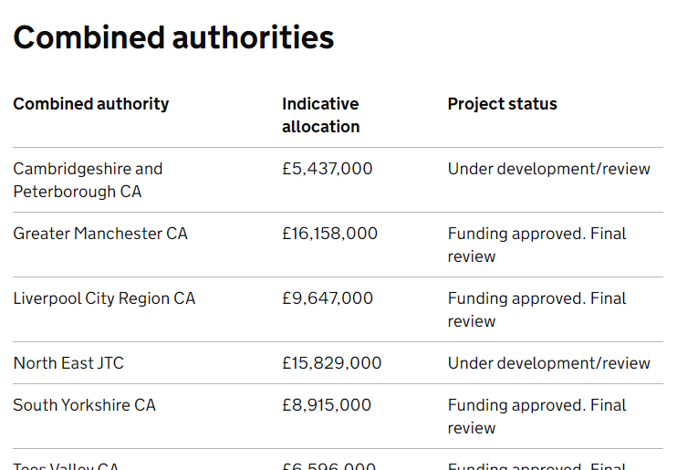
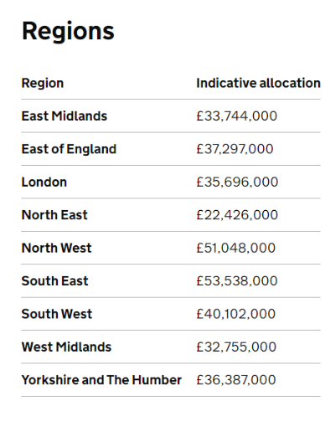
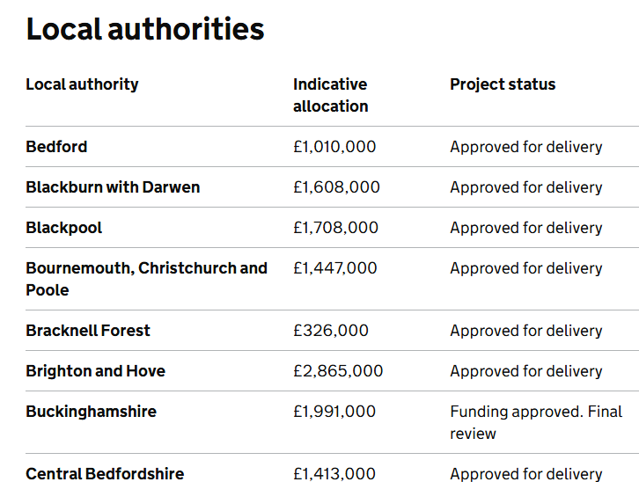
LEVI Capital Allocations PLUS Private Investment
90% Investment by Charge Point Operators
10% Capital Allocation
Total £3.5 Billion investment in National Infrastructure
Source: https://www.gov.uk/government/publications/local-ev-infrastructure-levi-funding-amounts/local-ev-infrastructure-levi-capability-funding-amounts
Notes:
LEVI scale of investment.

Slide 22
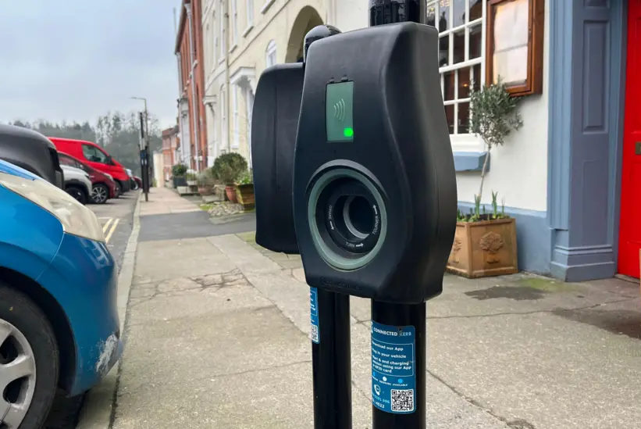
Local Authorities are key players
Developing local EV charging strategies
Local Authorities are best placed to engage with the public and local communities – understand the needs of their areas:
Rural / urban / suburban
Deprivation or have lacked investment
Local street scenes
Identifying areas – where residents don’t have off-street parking
Convenient
Close to home
Focus on-street and overnight parking
Notes:
Role of Local Authorities.

Slide 23
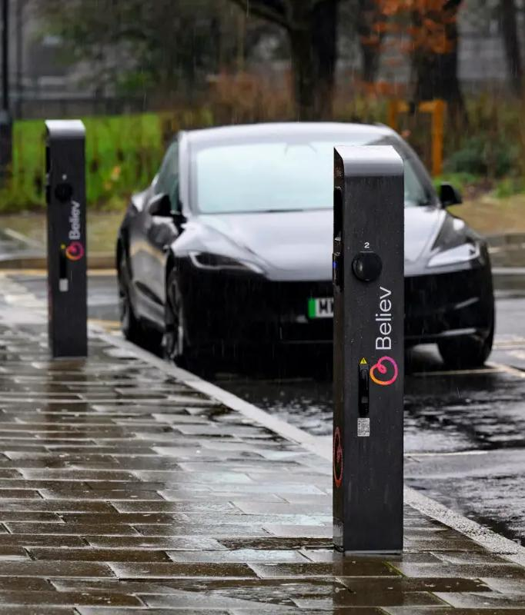
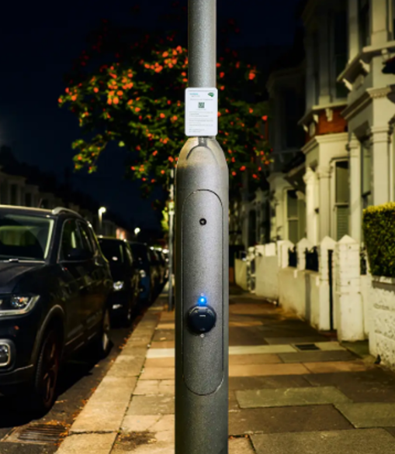
Types of on-street public charging
  Dedicated Charge Points
  Marked bays, typically 1-2 sockets per unit
  Flexible on location, easy on-street installation
  Adopting different designs and layouts to suit different street scenes and housing types.
Lamp Column Charge Points
Re-purpose existing infrastructure
Avoids additional civils for cabling, reducing installation costs
A variety of types available, can be visually unobtrusive. Single socket.
  Options to install on side streets, gable ends, avoiding contentious parking issues.
Not a possibility everywhere but offers a lower cost option particularly in places where pavement space is at a premium.
Notes:
Predominant types of public charging installed under LEVI.

Slide 24
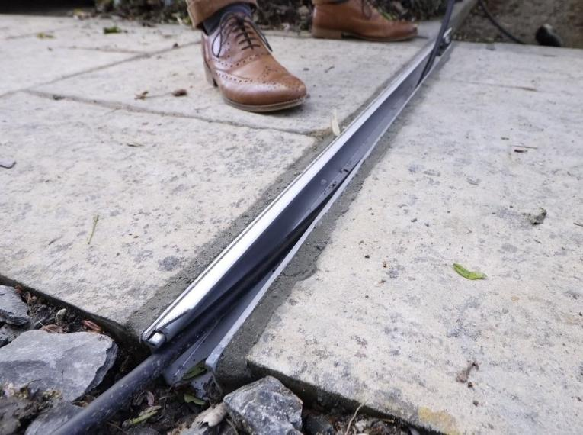
Home Charging via Cross Pavement Solutions
Cross Pavement Solutions (XPS) or Cable Gullies
These allow residents who don’t have off-street parking to charge electric vehicles (EVs) at home without trailing charging cables across the pavement.
Also known as cable gullies or pavement channels, these are usually enclosed channels in the pavement that safely fit the charging cable. Several suppliers now install them.
Source: https://energysavingtrust.org.uk/grants-and-loans/electric-vehicle-pavement-channels-grant/
Notes:
Cross pavement solutions.

Slide 25
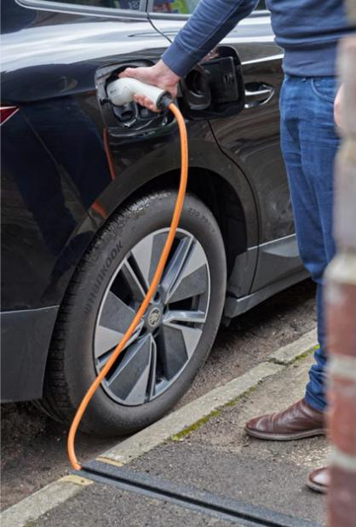
Home Charging via Cross Pavement Solutions
The Electric Vehicle (EV) Pavement Channels Grant is a £25 million capital fund for local authorities in England.
The objectives of the fund are to:
Empower local authorities in England to include cross-pavement channels in their EV strategies as a viable local charging solution.
Drive EV uptake by supporting residents without off-street parking to charge at home and benefit from cheaper domestic tariffs.
A supplement to public charging
Source: https://energysavingtrust.org.uk/grants-and-loans/electric-vehicle-pavement-channels-grant/
Notes:
EVPCG explainer.

Slide 26
South Warwickshire EV Procurement
Warwick District Council (WDC) & Stratford District Council (SDC) joint procurement for Charge Point Operator (CPO) for off-street council owned car parks.
Intention is to appoint a single Electric Vehicle Charge Point (EVCP) installer across South Warwickshire
To support residents without access to off-street parking/home charging.
Currently out to market with intention of first phase installation Q1 2027/28

Slide 27
The role of Local Communities

Slide 28

Local Communities are key players
Identifying sites - locating the charge points close to where people live, shop, work, travel, relax, i.e. in places where they will be well used
Local people are best placed to understand the needs of particular areas: rural, urban, those with deprivation or that have lacked investment

Slide 29
Community & Parish involvement
Some Town & Parish Councils and community groups have worked with CPOs to install EV chargers at town or parish halls or in car parks managed or owned by those councils.
Often this has been done with the support of the local Borough, District or County Council in order to achieve economy of scale, commonality of hardware, and make the charger part of a larger network.
Examples are Suffolk (see following video) & Kent.

Slide 30
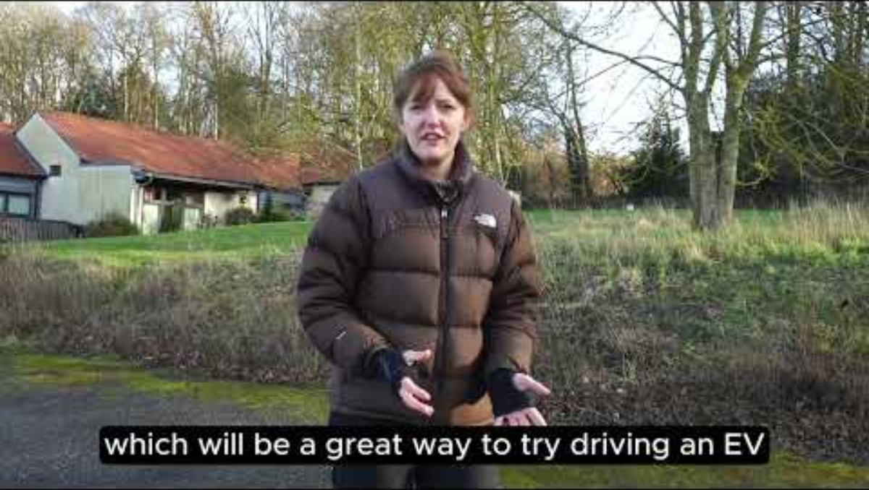

Slide 31
Community & Parish involvement
This can work well where there is clear ownership and good use of the charger.
It helps build a sense of community ownership and involvement.
Pitfalls of going it alone:
Direct ownership of a chargepoint may result in maintenance costs, ongoing fees for electricity bills that the parish may not be able to pick up long term.
Car park ownership & access needs to be clearly determined ahead of installation.
A charge point operating company may not be keen to work on a one-off local solutions & you might not get the best deal.
The charger may be used less than anticipated, or hardly at all. The majority of people will likely want to install home chargers.

Slide 32
Grants

Slide 33
Electric Vehicle Chargepoint Grants
For Flats and Renters
You can get 75% off the cost to buy and install a socket, up to a maximum of £500.
You can apply for this grant if you:
own and live in a flat
rent and live in any residential property (including properties under the shared ownership scheme)
You must own an eligible vehicle and your home must have its own private off-street parking space.
See website for additional terms & conditions. Available until 31 March 2027
https://www.find-government-grants.service.gov.uk/grants/electric-vehicle-chargepoint-grant-for-renters-and-flat-owners-1

Slide 34
Electric Vehicle Chargepoint Grants
For Residential Landlords
You can get 75% off the cost of buying and installing chargepoints up to a maximum of £500 per socket.
You can receive grants for up to 200 sockets per year.
Applicants must be registered at Companies House or VAT registered.
See website for additional terms & conditions. Available until 31 March 2027
https://www.find-government-grants.service.gov.uk/grants/electric-vehicle-chargepoint-and-infrastructure-grants-for-landlords-1

Slide 35
Electric Vehicle Chargepoint Grants
For Households with On-Street Parking
Provides support towards the costs of the purchase and installation of EV chargepoints at residential properties if they are also installing a cross-pavement charging solution (e.g. a cable channel).
You can get 75% off the cost to buy and install a socket, up to a maximum of £500.
Make sure you have permission from your local highways authority for the installation of the cross-pavement charging solution. You must also declare in your application that you will obtain planning permissions as required by your local planning authority
See website for additional terms & conditions. Available until 31 March 2027
https://www.find-government-grants.service.gov.uk/grants/electric-vehicle-chargepoint-grant-for-households-with-on-street-parking-1

Slide 36
Electric Vehicle Chargepoint Grants
Workplace Charging Scheme - Support towards the cost of installing up to 40 electric vehicle chargepoint sockets at their sites.
The scheme covers up to 75% of the total costs of the purchase and installation of EV chargepoints (including VAT), capped at a maximum of:
£500 per socket
40 sockets across all sites per applicant – for instance, if you want to install them at 40 sites, you will have 1 socket available per site
It is open to eligible: Businesses, Charities, public sector organisations, small accommodation businesses
https://www.find-government-grants.service.gov.uk/grants/workplace-charging-scheme-2

Slide 37

EVISS webinar feedback – Click to Fill out form
https://forms.office.com/e/Mi16TthV9g
Or scan QR code
Select
“Engaging Local Communities”
Notes:
Breakout form link: https://forms.office.com/e/V5Wz0ruH3e

Slide 38
Thank you. Questions?
If you have any further questions or queries, please contact swclimate.engagement@warwickdc.gov.uk
South Warwickshire Local Climate Engagement Programme is climatechange.southwarwickshire.org.uk
Energy Saving Trust
Sept 2026

